Slide 1
Mechanical Advantage & Pulley Systems

Slide 2
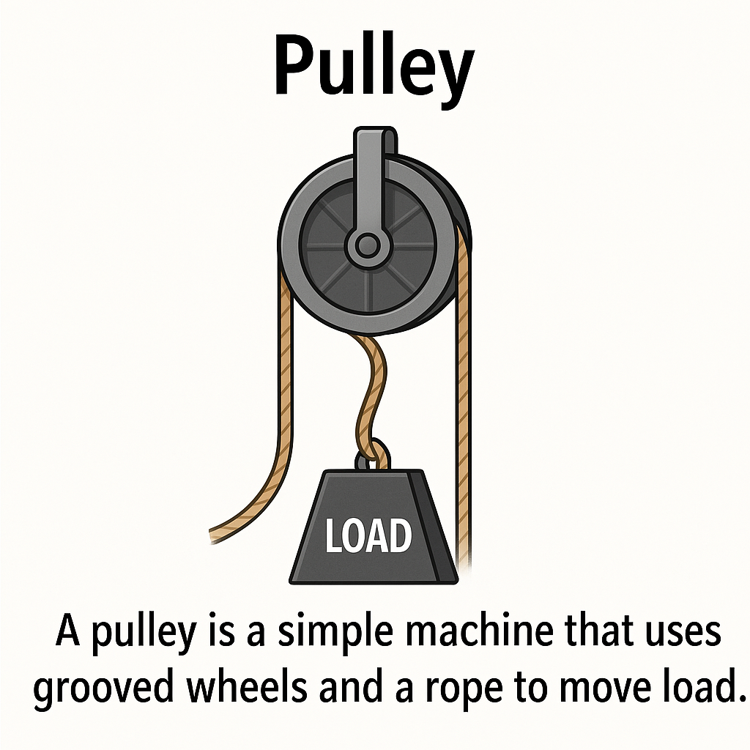
What is a Pulley?
A pulley is a simple machine that uses grooved wheels and a rope to move a load.
Notes:
"If the load is 18kg, and you only need to pull 9kg — the M.A is 2!"

Slide 3
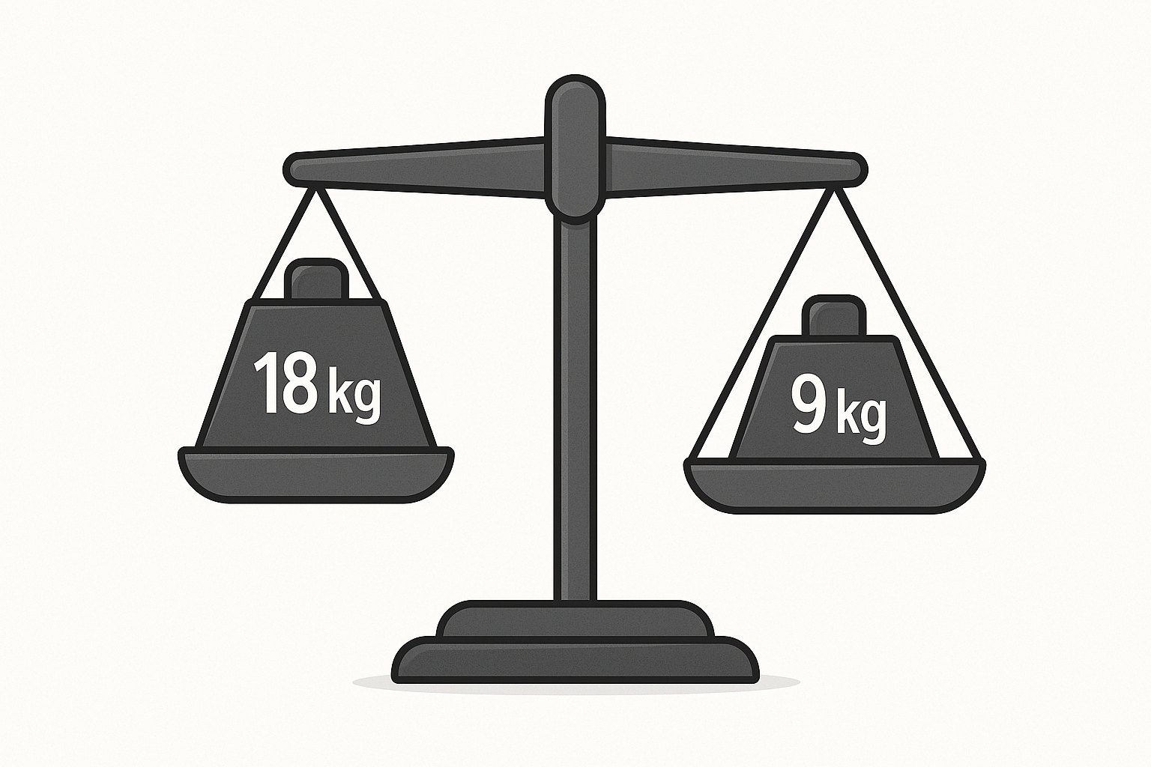
What is Mechanical Advantage (M.A)?
Mechanical advantage is how much a machine multiplies your effort.
Notes:
"If the load is 18kg, and you only need to pull 9kg — the M.A is 2!"

Slide 4
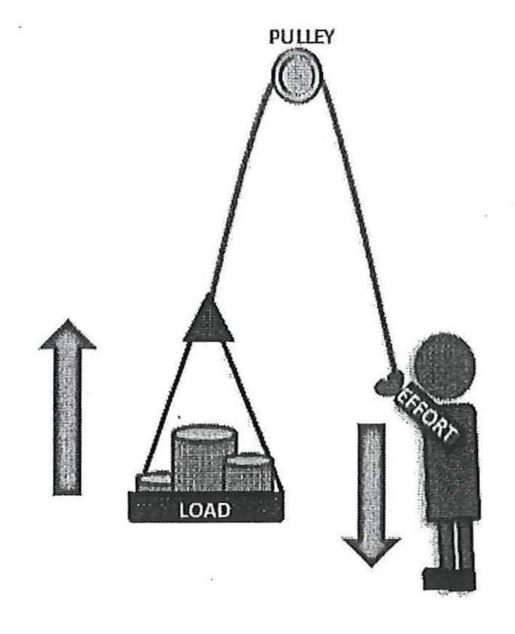
Fixed Pulley
Pulley is attached to a structure
Changes direction of force only
No mechanical advantage (M.A = 1)

Slide 5
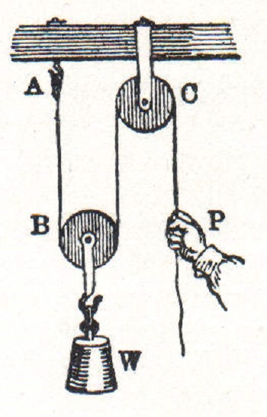
Moveable Pulley
Pulley is attached to the load
Moves with the load
M.A = 2 (makes it easier to lift)

Slide 6
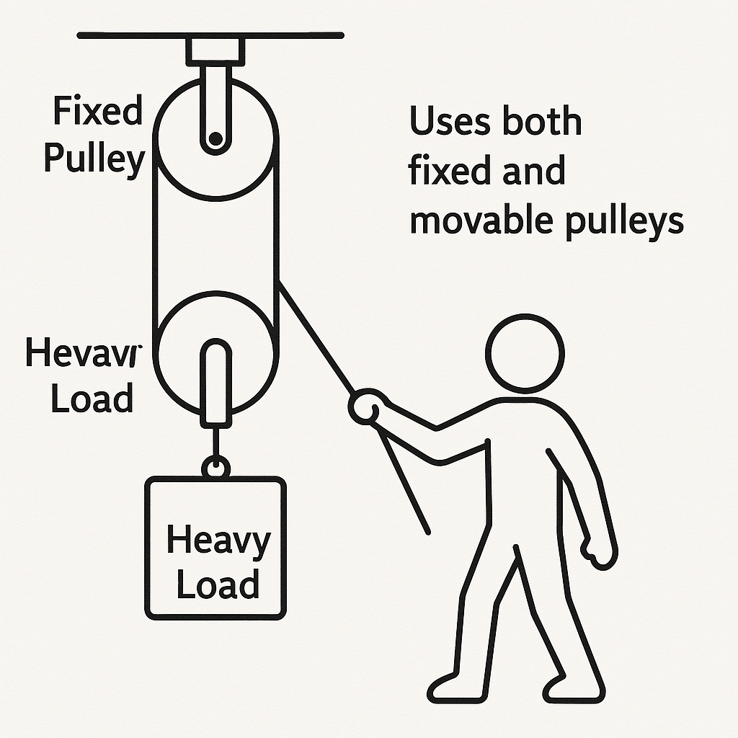
Compound Pulley Systems
Uses both fixed and movable pulleys
Enhances mechanical advantage
Simplifies lifting heavy loads

Slide 7
https://www.youtube.com/watch?v=pxD3SHMp9Es

