Slide 1
Repeating Patterns

Slide 2
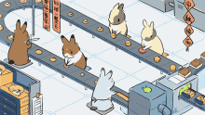
What are we learning?
Idea of “Repeating”
Describe how a repeating pattern continues
Create my own repeating patterns!

Slide 3

What is pattern?
Exploring “Patterns” around us
  🎵 Music (beats, rhythm) https://www.youtube.com/watch?v=CCHdMIEGaaM
  🎨 Art (designs, shapes)
  🌿 Nature (leaves, shells)
A pattern is something that repeats or changes in a predictable way.

Slide 4
Repeating vs Growing Patterns
Repeating Pattern
🔵/🔴/🔵/🔴/🔵/🔴 →
Growing Pattern:
🟩/ 🟩🟩/ 🟩🟩🟩 →

Slide 5
Identify the Pattern
🔶 🔶 🔷 🔷 🔶 🔶 🔷 🔷 ❓
What comes next?
Can you describe it in word?
The pattern repeats every four shapes: two orange diamonds and two blue diamonds.

Slide 6
Find the 18th Term
Pattern: 🟢 🟢 🔴 🟢 🟢 🔴 ...
💡 Tip: Write the cycle and count carefully!
Question: What color will be the 18th term?
🟢 🟢 🔴 🟢 🟢 🔴 🟢 🟢 🔴 🟢 🟢 🔴 🟢 🟢 🔴 🟢 🟢 🔴
1 2 3 4 5 6 7 8 9 10 11 12 13 14 15 16 17 18

Slide 7
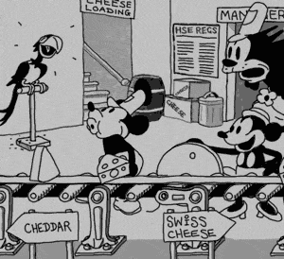
Create Your Own Pattern!
Use shapes, colors, or numbers to make your own pattern. (Show me 3 different pattern)
👉 Write the rule under your pattern
(e.g., “Add 1 more each time” or “Repeat after 3 shapes”).
Show Mr. Joo after you finish your work.

