Slide 1
Persuasive Writing
I Wanna…

Slide 2
We should play chess during recess
Playing chess during recess is a great way to build our brains.
That’s why we should have a chance to play chess during our break time.
For example, when I play chess, I have to think carefully about my next move, which helps me stay focused.
Chess teaches us how to think ahead and solve problems.

Slide 3
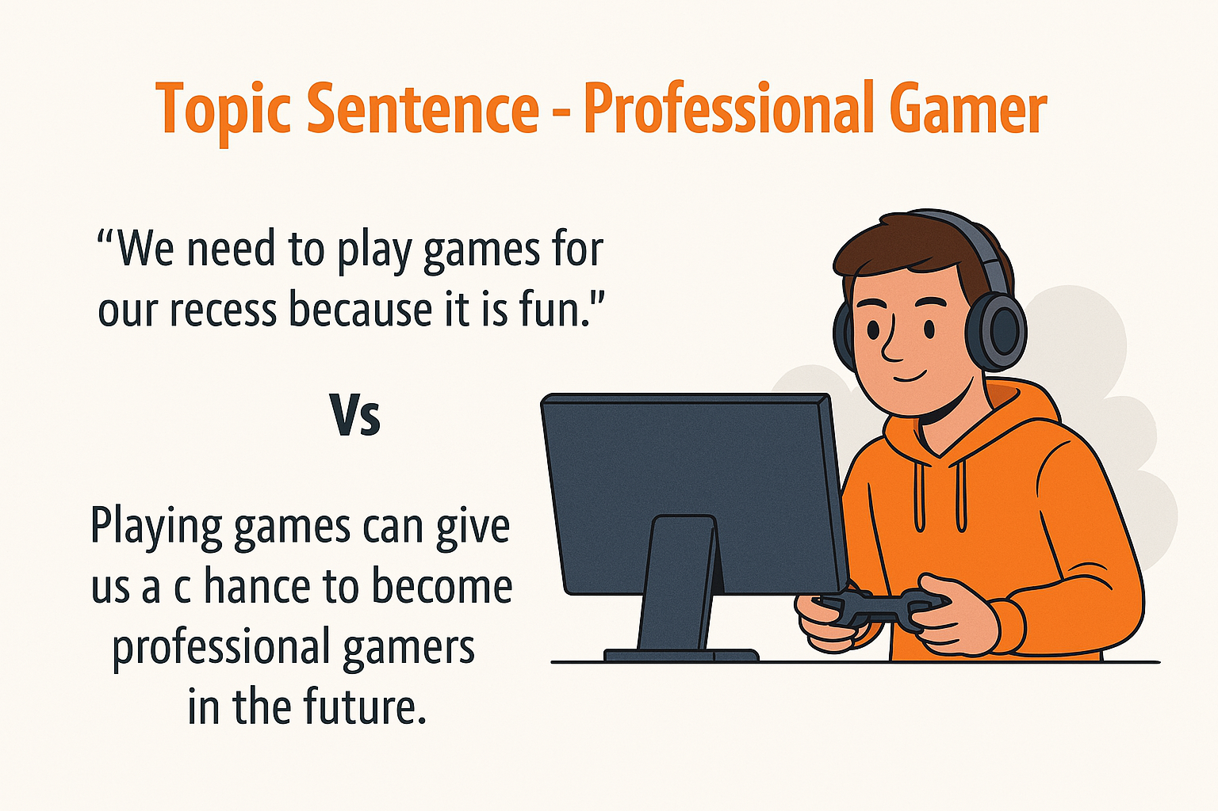

Slide 4
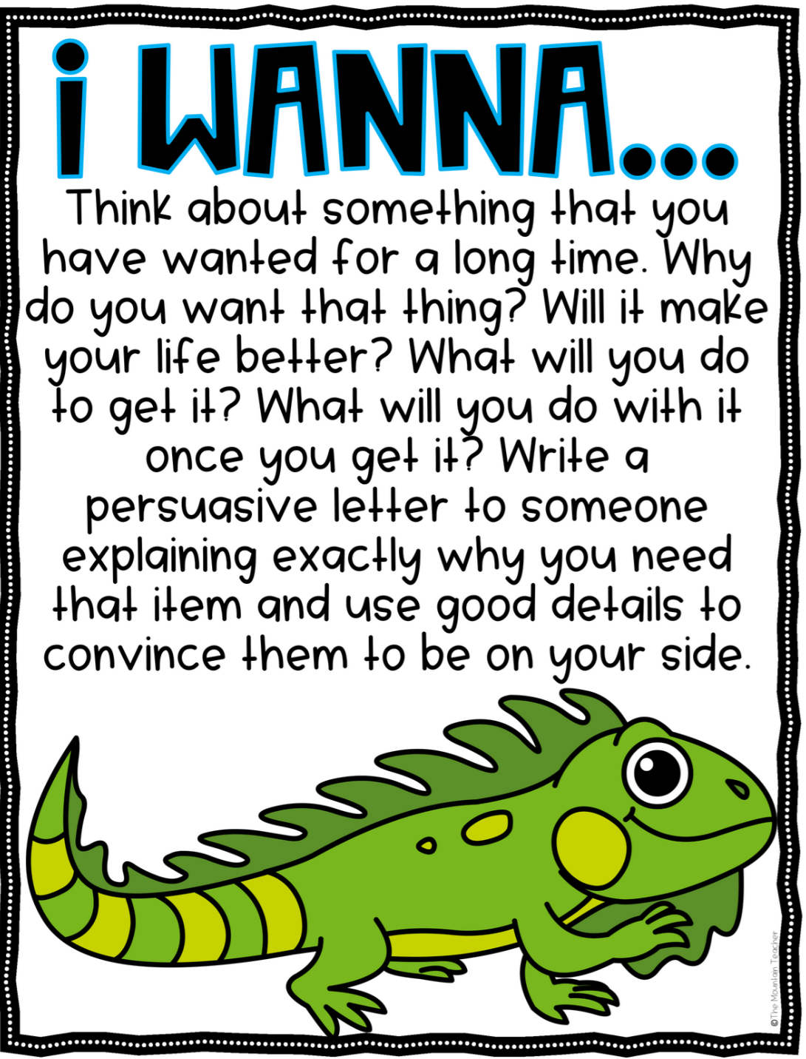
I Wanna…

